Slide 1
Using the Metanorma Toolchain to Author OGC Standards
The 121st OGC Member Meeting
Ronald Tse, Ribose
9 December 2021

Slide 2
Part 1

Slide 3
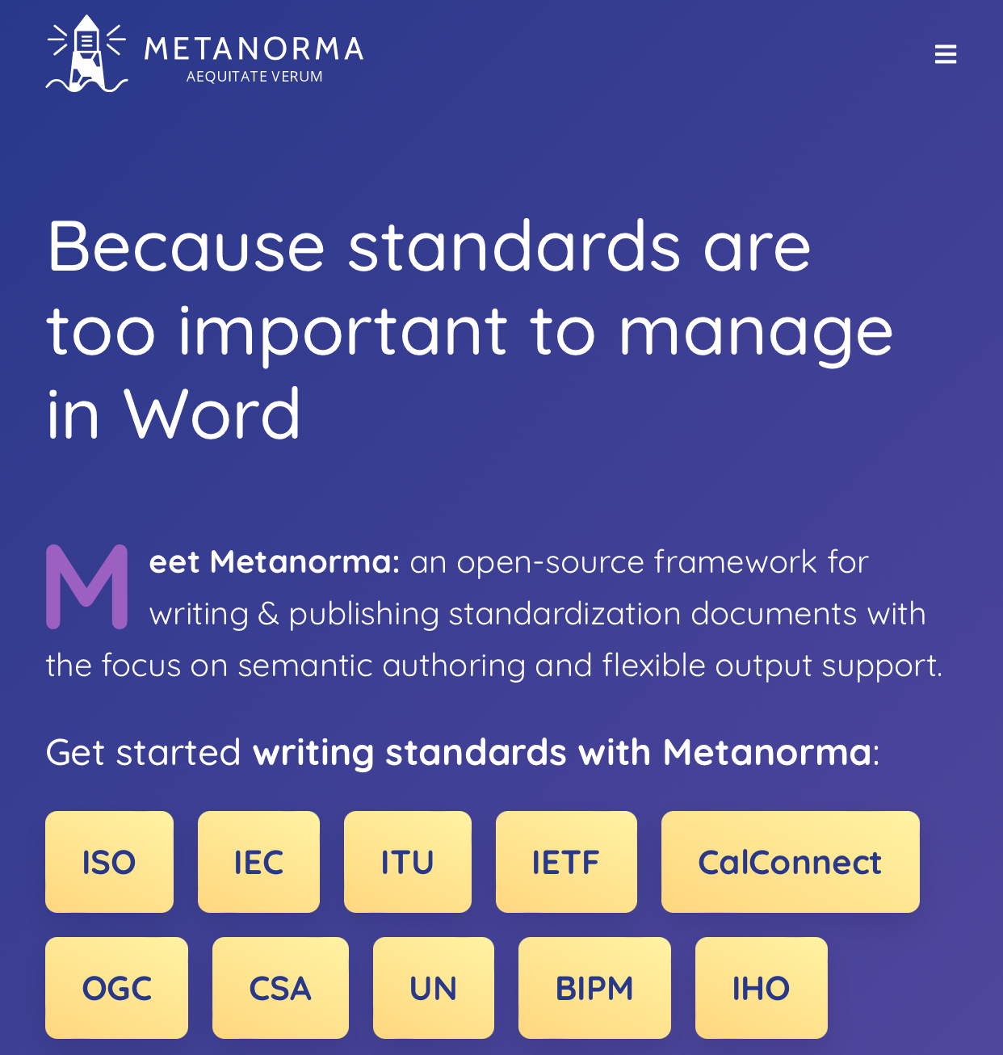
Metanorma is the leading open-source standards authoring suite
Open-source, model-based authoring suite
Supports over 15 SDOs (private: NIST, BSI, BIPM)
Focuses on end-to-end generation of deliverables: WYMIWYG (what you mean is what you get)
Underlying metamodels standardized in ISO 36100 (WD)
OGC Testbed 17 participant

Slide 4
Metanorma features
Auto bibliography fetching
Smart concept references
Accessibility (WCAG 2.0, Section 508)
PDF encryption and permissions
Accessible math: AsciiMath, LaTeX math, MathML
Proxy support
Third-party font support
LaTeX input support
ISOSTS / NISO STS output
Template support
Single command install
…

Slide 5
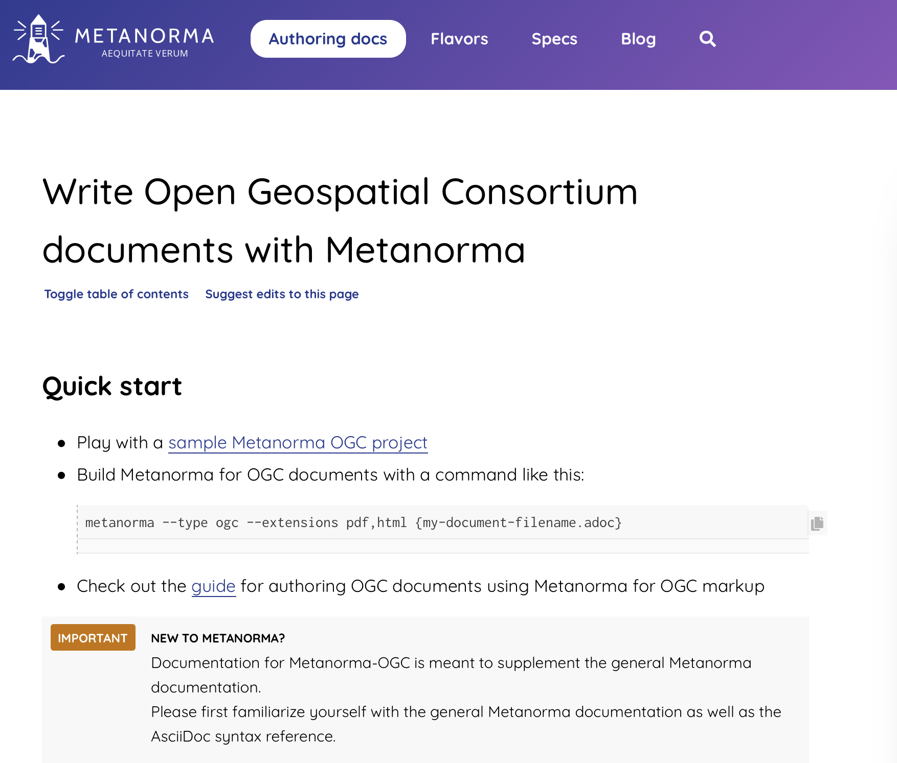
Metanorma has been working with OGC DocTeam for nearly 4 years
Dedicated OGC authoring site
Supports
all document types (and sub-types, abbreviations)
all document stages
Document templates and samples
Supports ModSpec
Preface sections

Slide 6
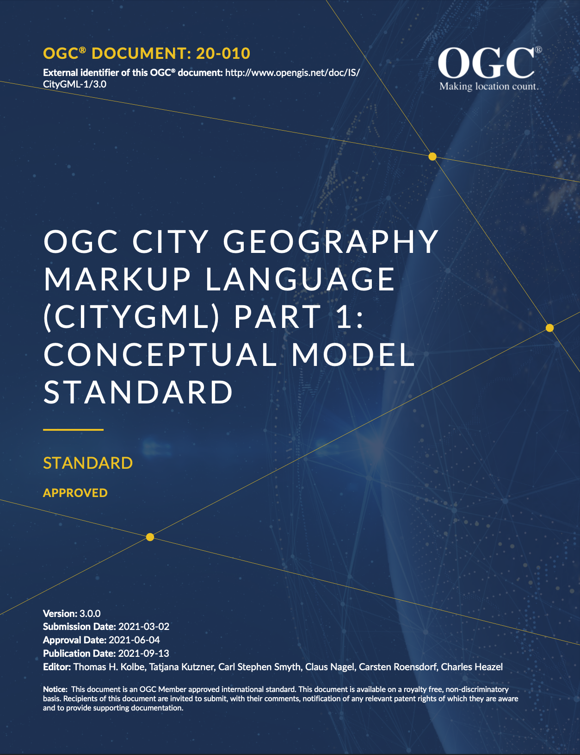
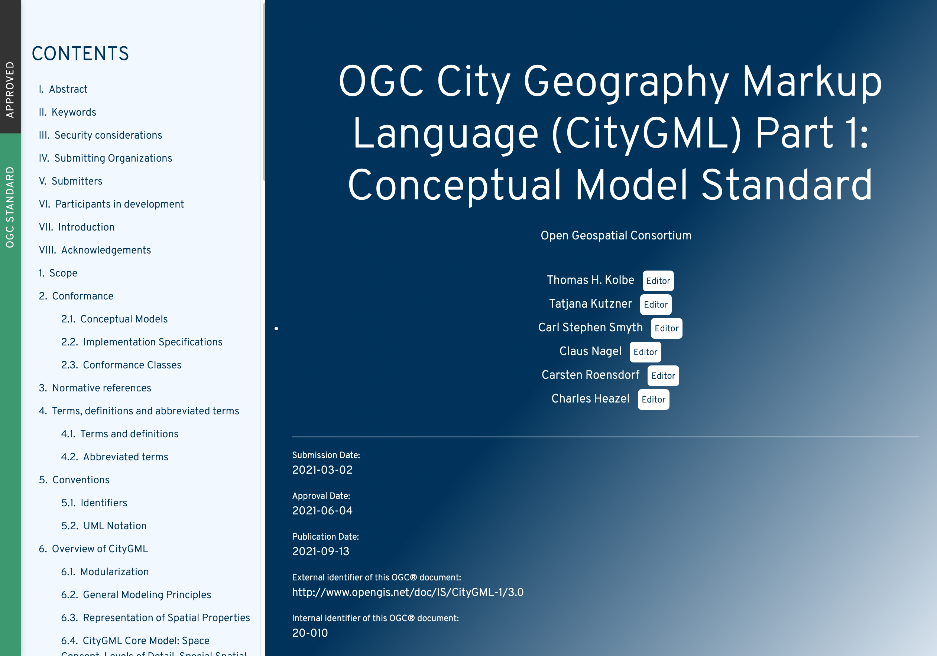
CityGML 3.0 was published in Metanorma using a single step model-based workflow (TB 17)

Slide 7
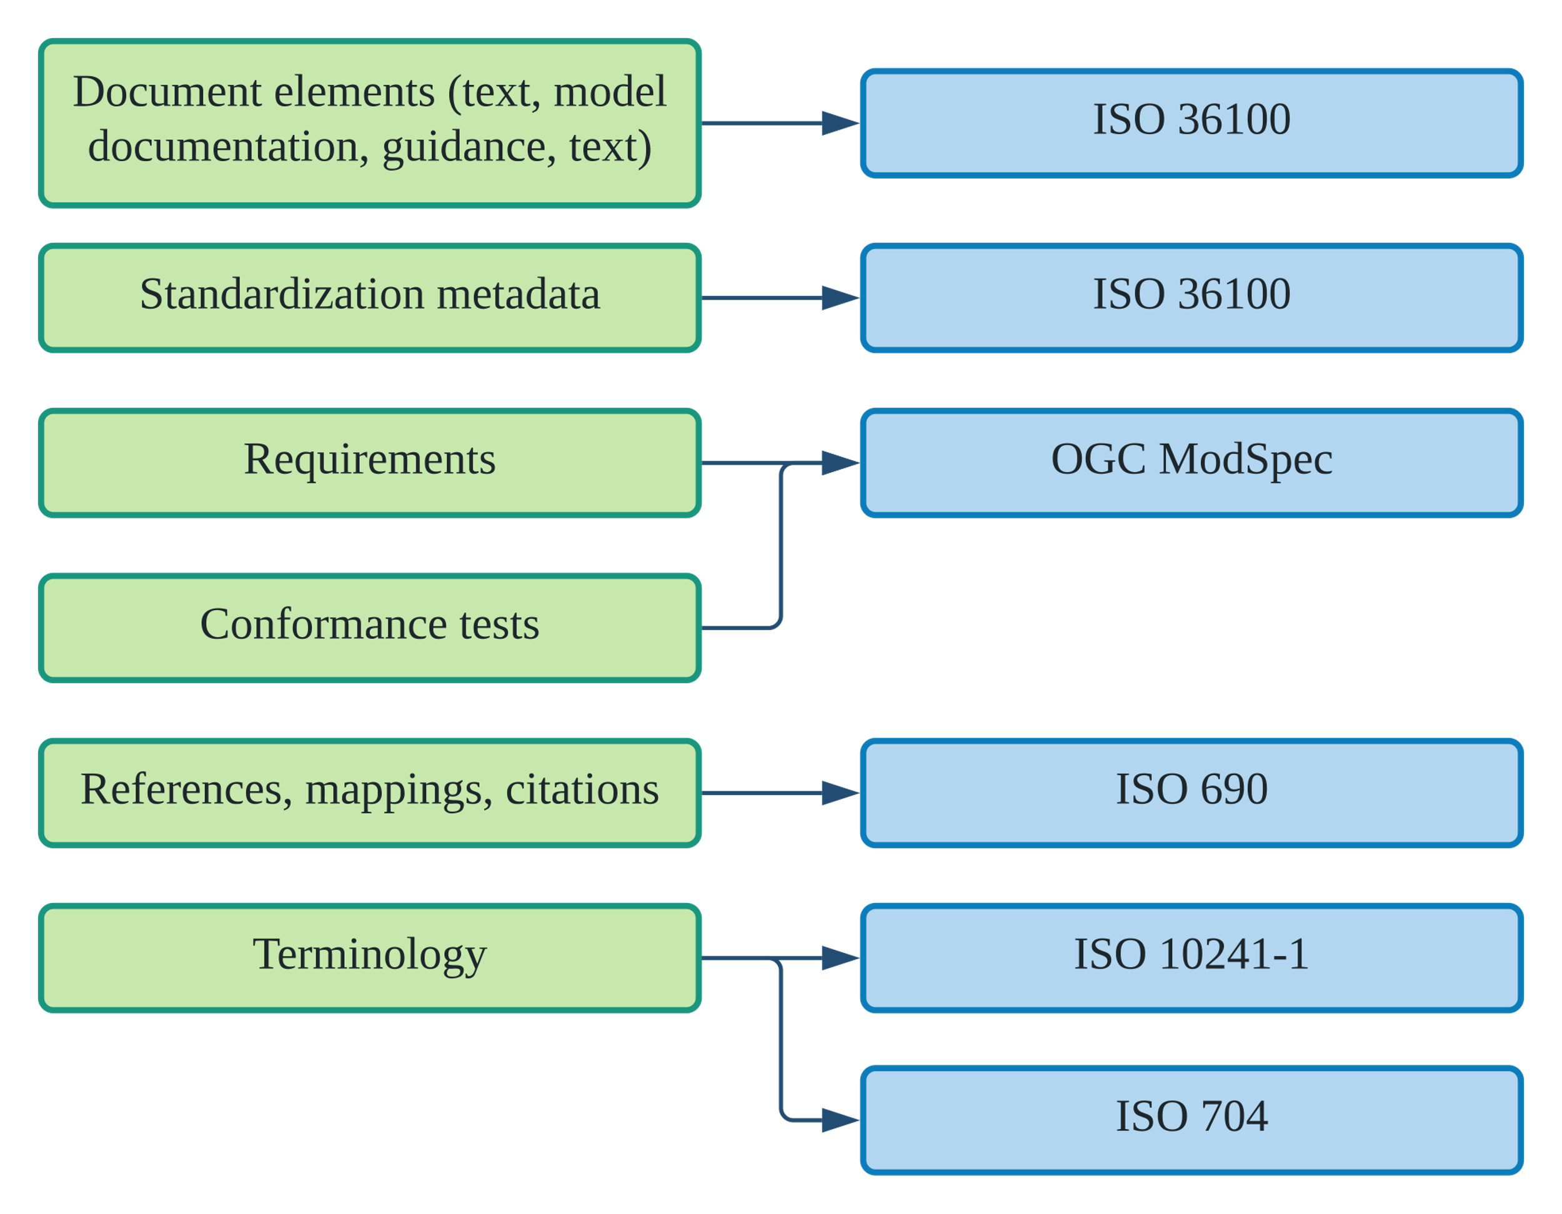
Metanorma adopts model-based processing

Slide 8
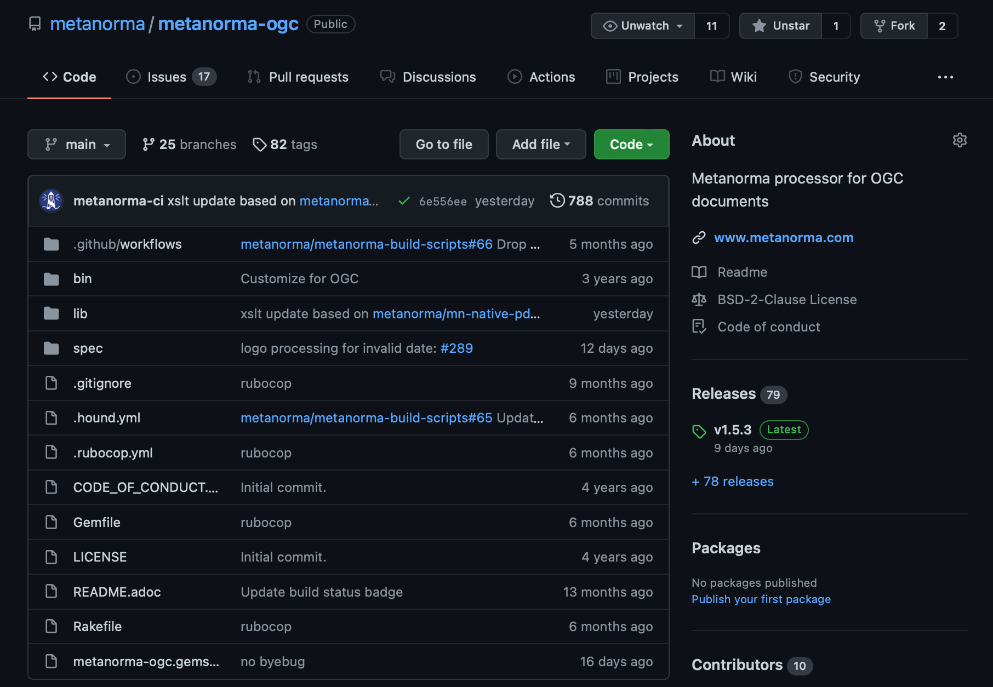
Metanorma for OGC is active in development
205 closed issues
788 commits
79 releases

Slide 9
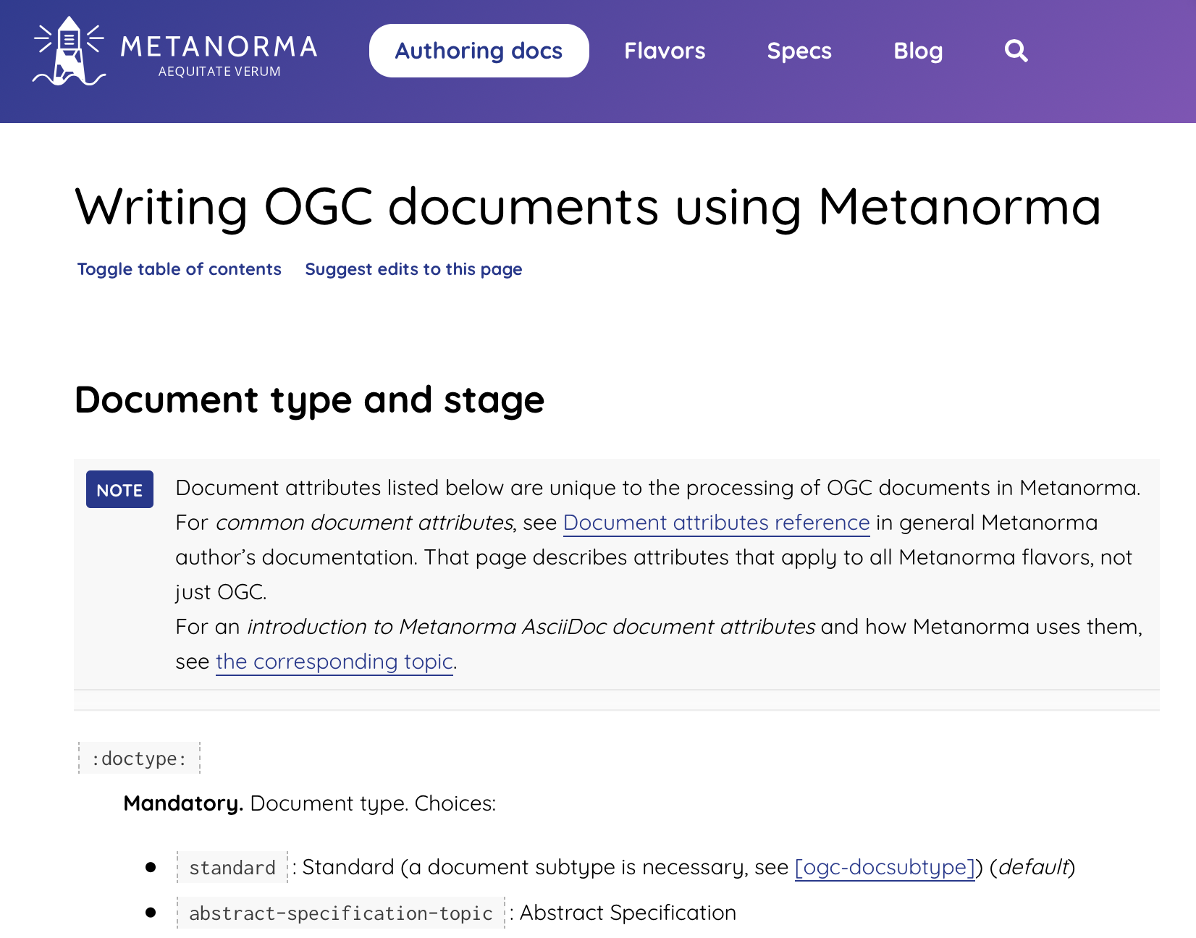
Metanorma OGC authoring guide
Everything that is OGC specific:
Document types
Document subtypes
Document status
Keywords
Bibliographic features
Preface section encoding
Document dates
Requirements
https://www.metanorma.org/author/ogc/

Slide 10
Agenda today
Creating a document
Metanorma AsciiDoc
Document header
Document types and stages
Clauses and Annexes
Preface sections
Terms and definitions
References
Document templates
Document samples
ModSpec encoding
Where to find information?
The OGC authoring guide
Installation
Working with a real document
Getting hands dirty!

Slide 11
Part 2

Slide 12
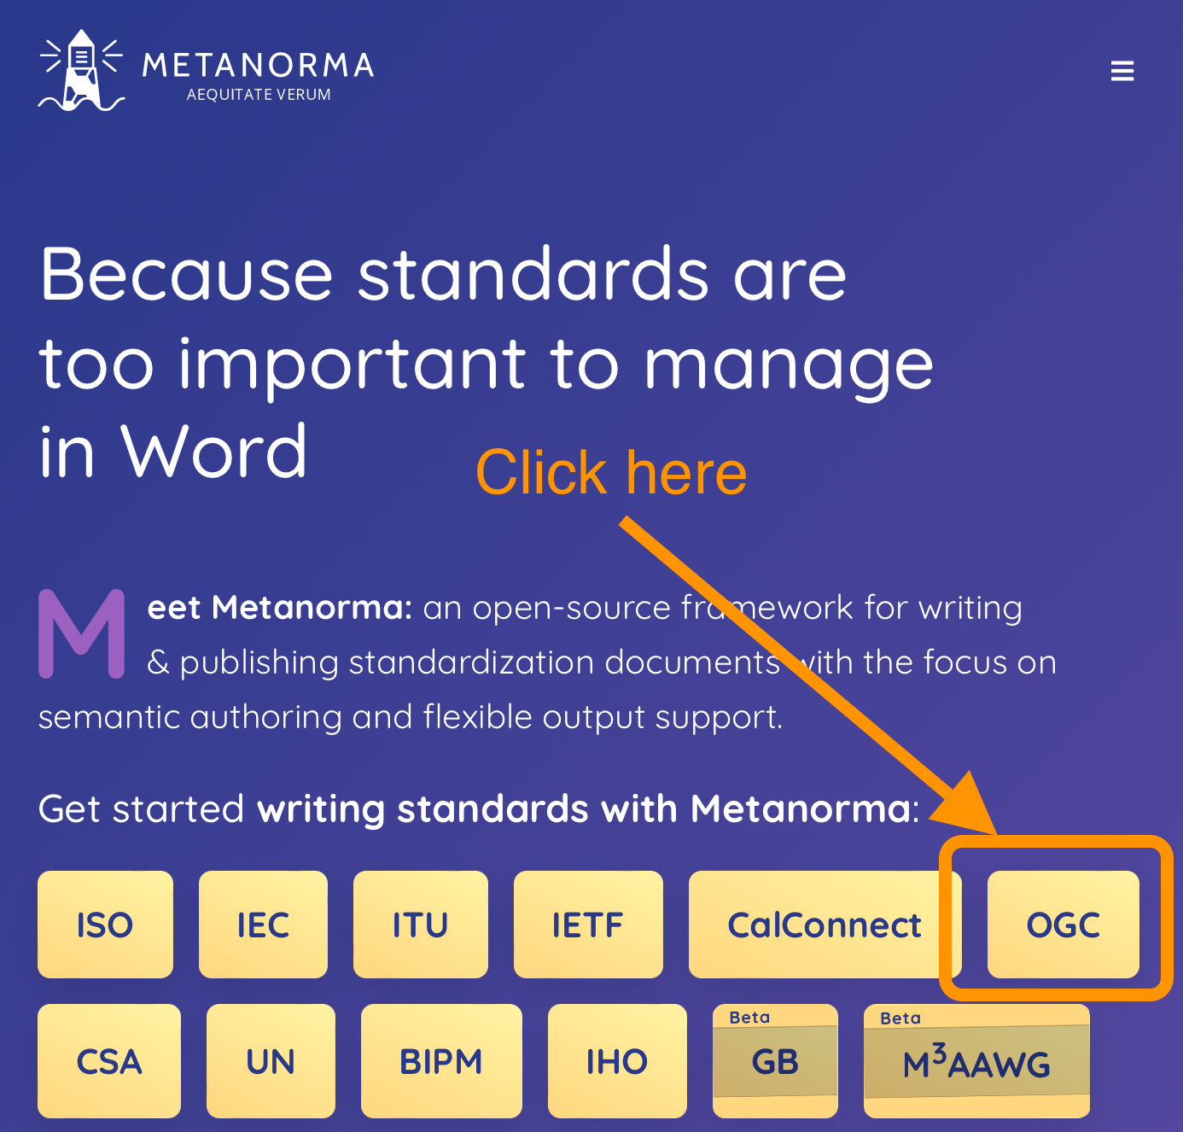
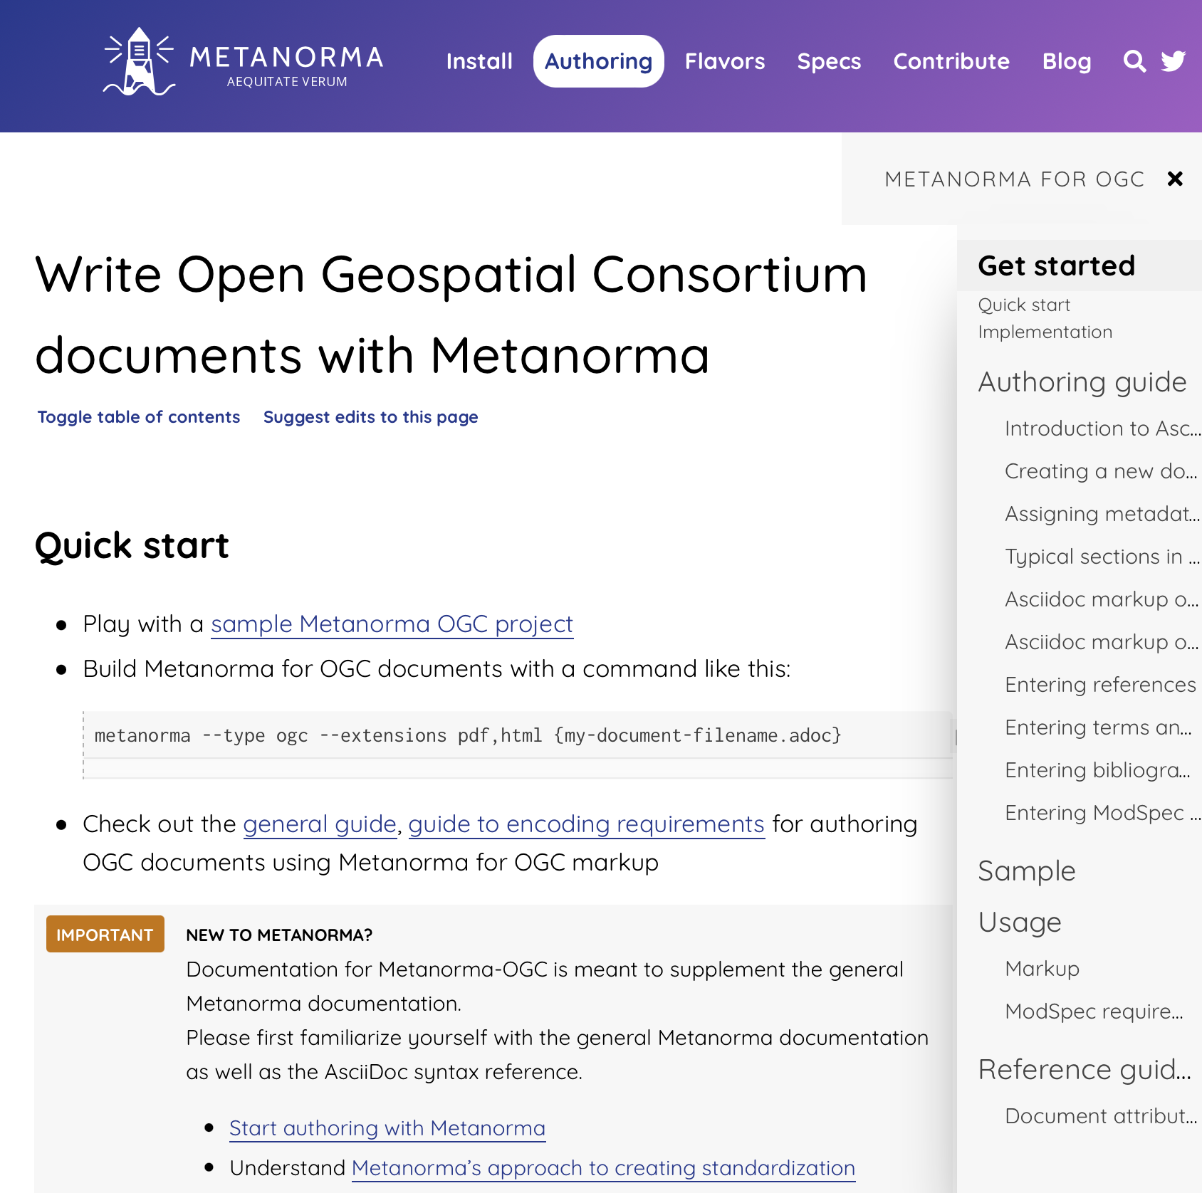
Where to find information?
Authoring
guide
Markup and ModSpec
Document attributes

Slide 13
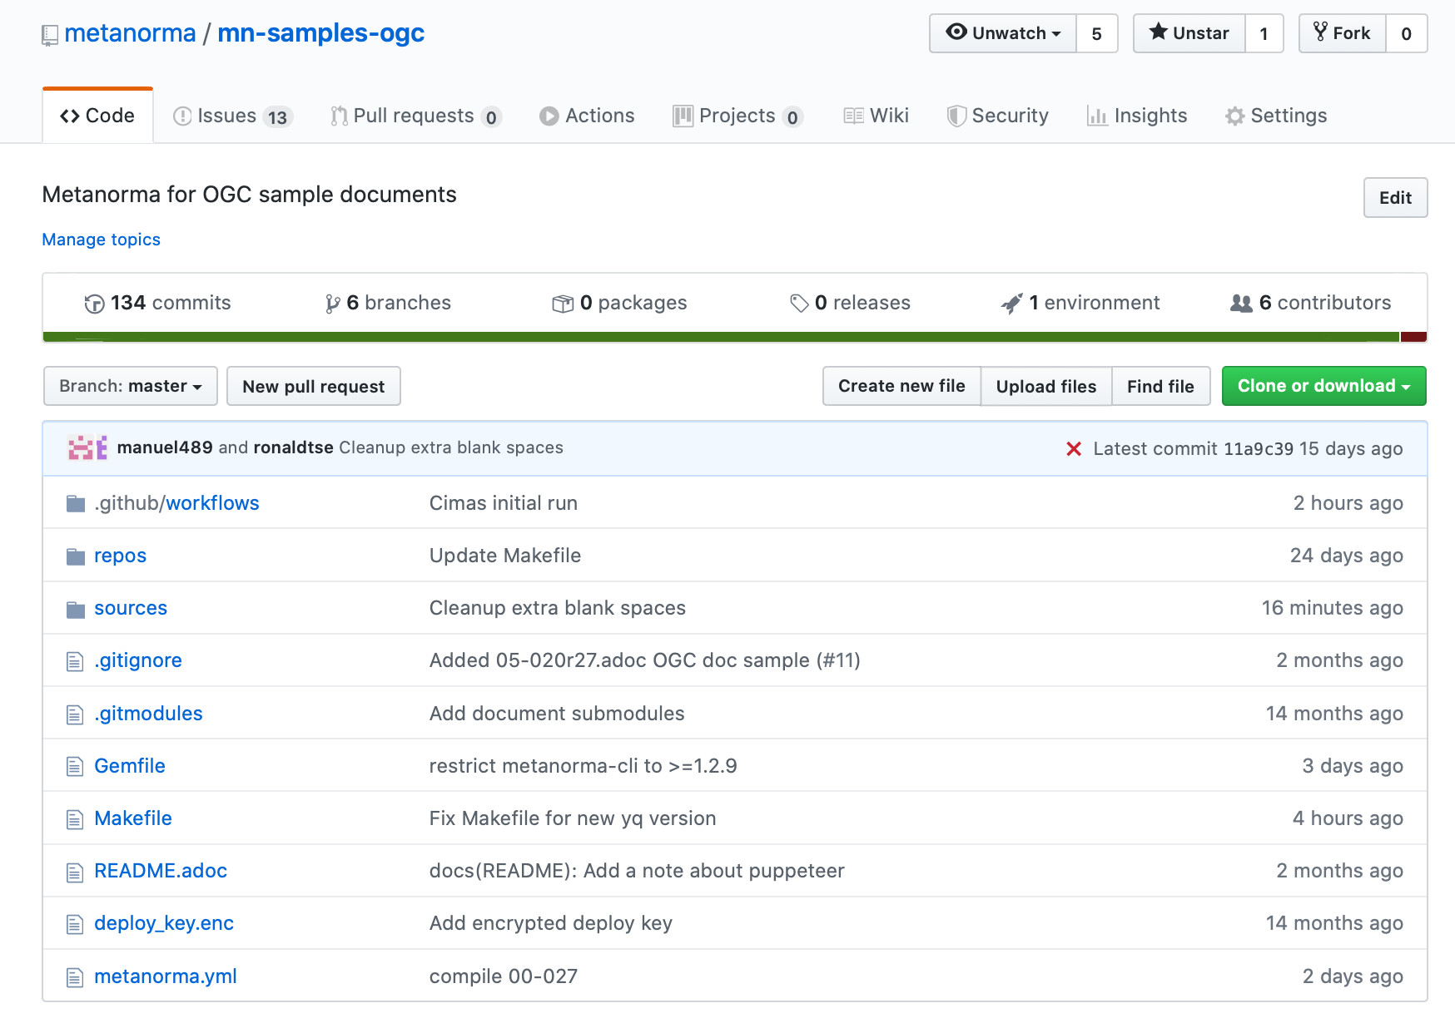
Repo for OGC document samples
OGC document samples available here:
https://github.com/metanorma/mn-samples-ogc

Slide 14
Many OGC document samples now available
Standard, subtype implementation: 17-069r3
Abstract specification topic: 15-104r5
Best practice, subtype general: 16-114r3, 15-120r5
Discussion paper: 19-004
Whitepaper: 16-131r2
Release notes: 18-016r1
Community standard: 18-053r2
Engineering report: 18-046
Reference model: 08-062r7
User guide: 16-080
Policy: 05-020r27
Profile: 10-100r3
Tech corrigendum: 14-065r2
Standard, with suite:
Test suite: 00-027
Community practice 18-097r3

Slide 15
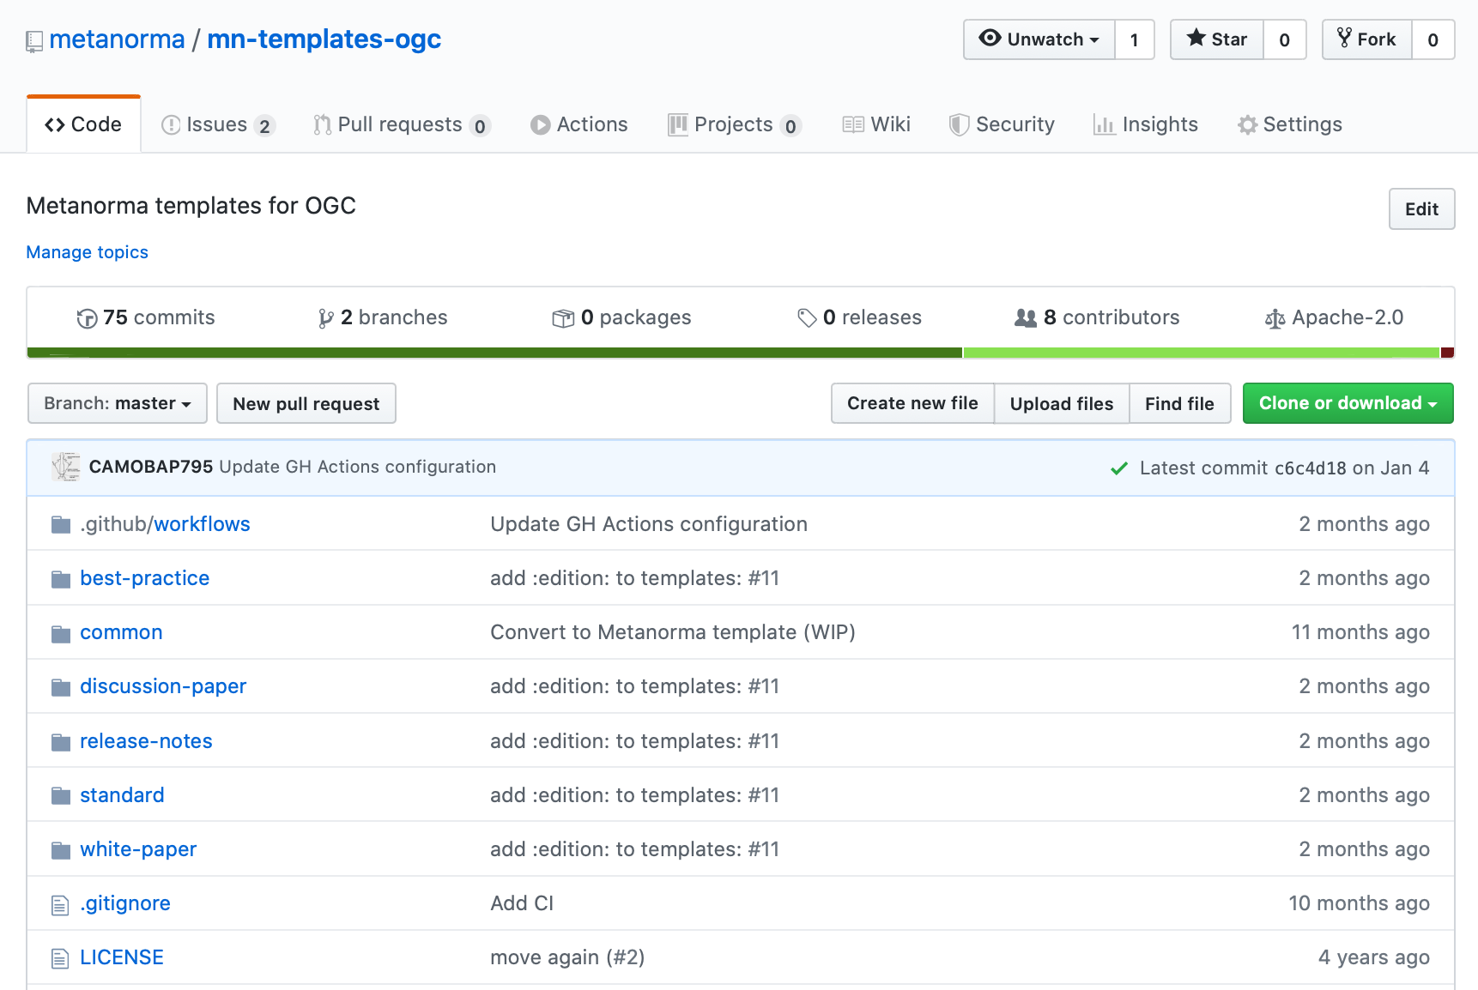
OGC document templates
Generate a document folder with an OGC template
$ metanorma new my-ogc-document -t ogc -d standard
Template types available:
Best practice
Discussion paper
Release notes
Standard
Whitepaper

Slide 16
Font management in Metanorma
OGC uses the Lato font, an open-source font that is not installed by default on major OSes, for PDF
Available on Adobe Fonts and Google Fonts
Metanorma helps you install all necessary fonts, as long as you “agree to font terms”!
`metanorma mydoc.adoc --agree-to-terms`

Slide 17
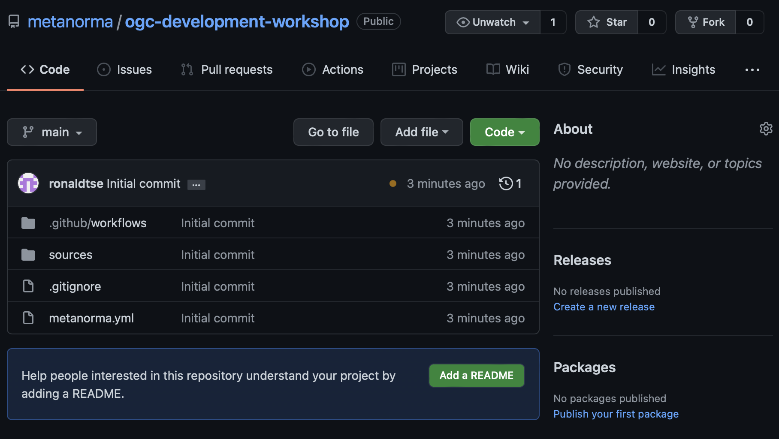
Let’s try compiling a document (18-095r7)!
https://github.com/metanorma/ogc-development-workshop
Docker/Linux (recommended) https://www.metanorma.org/install/docker/
macOS: https://www.metanorma.org/install/macos/
Windows: https://www.metanorma.org/install/windows/

Slide 18
Steps
Local install run:
metanorma site generate --agree-to-terms
Docker on Linux/macOS:
Docker on Windows (cmd) run:
docker run ^
-v %cd%:/metanorma ^
-v %USERPROFILE%\.fontist\fonts:/config/fonts ^
-w /metanorma ^
-it ^
metanorma/mn ^
metanorma site generate --agree-to-terms
docker run \
-v "$(pwd)":/metanorma \
-v "${HOME}/.fontist/fonts":/config/fonts \
-w /metanorma \
metanorma/mn \
metanorma metanorma site generate --agree-to-terms

Slide 19
Now that we can compile let’s try updating it
Let’s pretend we want to update this document to satisfy the latest rules.
Terms and definitions should be in Clause 3
Missing submitter organizations
How to fix?
Can we get rid of these warnings?
Metanorma XML Style Warning: (XML Line 000227): Hanging paragraph in clause
Metanorma XML Style Warning: (XML Line 000678): Hanging paragraph in clause
Metanorma XML Style Warning: (XML Line 000794): Hanging paragraph in clause
Metanorma XML Style Warning: (XML Line 001195): Figure should have title
Metanorma XML Style Warning: (XML Line 000091): Table should have title
Metanorma XML Style Warning: (XML Line 001349): Table should have title

Slide 20
Thank you, questions welcome!

